Slide 1
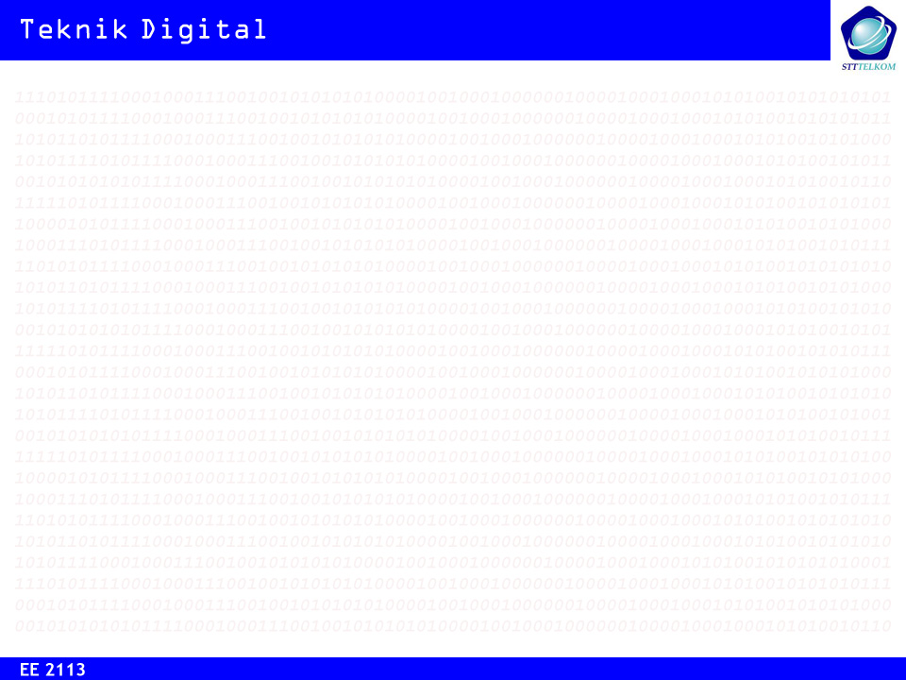
Analisa dan Sintesa
Rangkaian Sekuensial
(SM: State Machine)

Slide 2
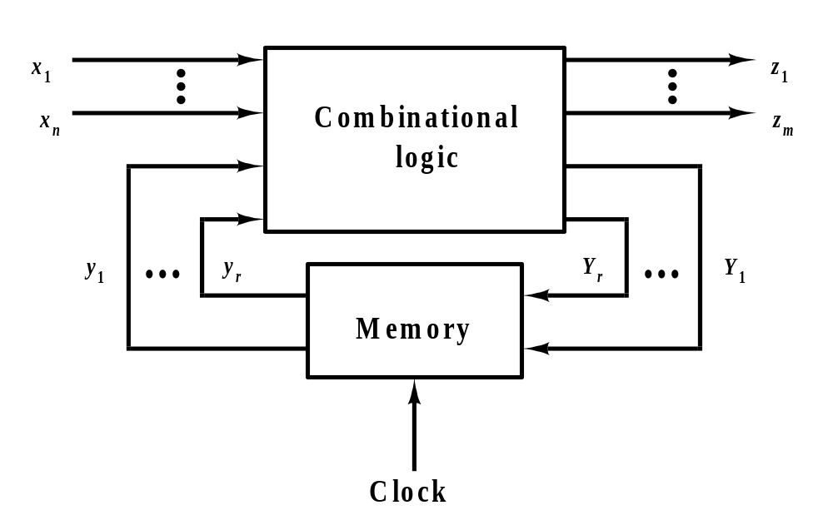
Model Rangkaian Sekuensial (SM)
Ciri khas SM: Rangkaian memiliki kemampuan menyimpan state keluaran sesaat sebelumnya

Slide 3
Model SM
MEALY: Model umum SM di mana state output bergantung pada state input dan state sekarang.
MOORE: Penyederhanaan model Mealy di mana state output hanya bergantung pada state sekarang.

Slide 4
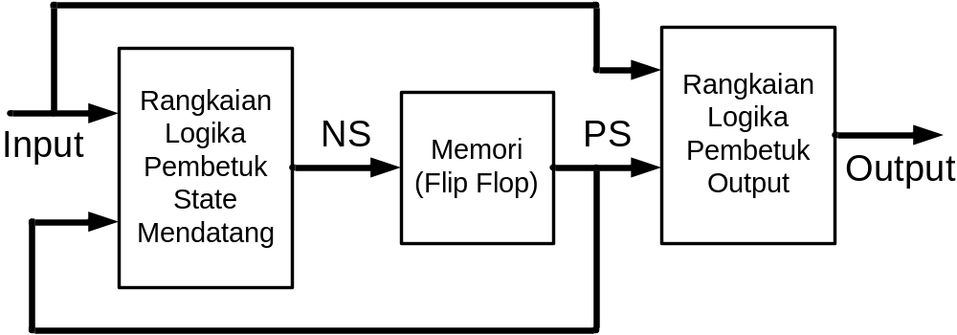
Model Mealy
NS: Next State = State Mendatang
PS: Present State = State Sekarang

Slide 5
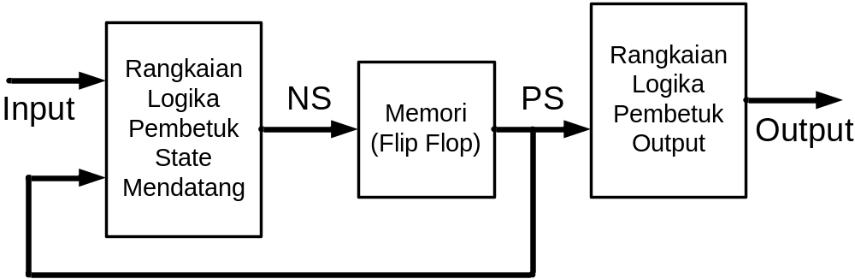
Model Moore
NS: Next State = State Mendatang
PS: Present State = State Sekarang

Slide 6
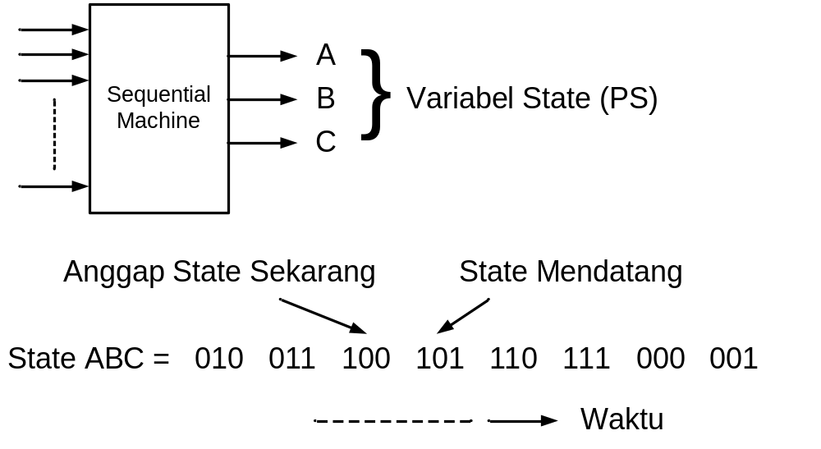
Runtutan/Sekuen State Logika

Slide 7
Banyak State
Bila suatu SM memiliki N variabel state, maka maksimal akan ada 2^{N} state dan minimal 2, atau
2 < (Banyak state) < 2^{N}

Slide 8
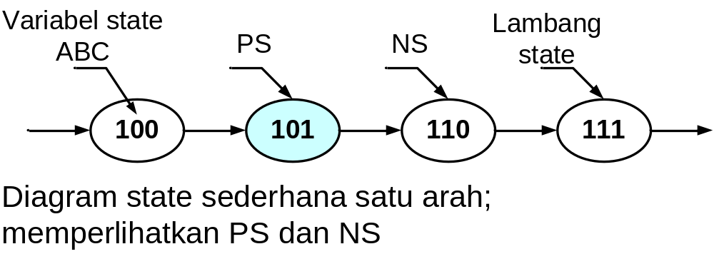
Diagram State (1)

Slide 9
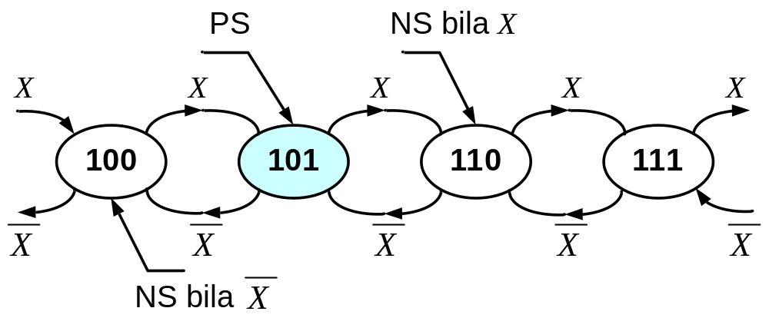
Diagram State (2)
Diagram state dua arah, SM memiliki variabel input X. Menuju ke kanan saat X dan ke kiri saat‾X.

Slide 10
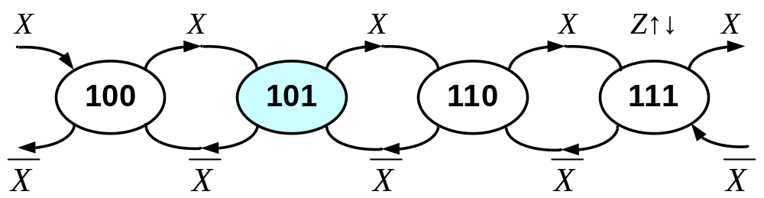
Diagram State (3)
Diagram state dua arah. Z variabel output, aktif saat state 111 dicapai; Kasus Model Moore.

Slide 11
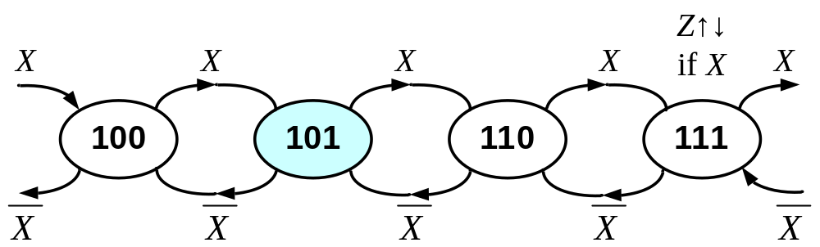
Diagram State (4)
Diagram state dua arah. Z variabel output, aktif saat state 111 dicapai dan saat variabel input X aktif (saat menuju ke kanan); Kasus model Mealy.

Slide 12
Aturan #1 Diagram State
Penjumlahan (logika OR) semua kombinasi variabel input yang keluar dari suatu state harus sama dengan ‘1’

Slide 13
Dasar Analisa & Sintesa SM (1)
1. Kenali tabel eksitasi/tranformasi FF yang dipakai
Q_{t} → Q_{t+1} | S R
0 → 0 0 → 1 1 → 0 1 → 1 | 0 φ 1 0 0 1 φ 0
Q_{t} → Q_{t+1} | D
0 → 0 0 → 1 1 → 0 1 → 1 | 0 1 SET 0 1 SET HOLD

Slide 14
Dasar Analisa & Sintesa SM (2)
1. Kenali tabel eksitasi/tranformasi FF yang dipakai (lanjutan)
Q_{t} → Q_{t+1} | T
0 → 0 0 → 1 1 → 0 1 → 1 | 0 RST HOLD 1 TOGGLE 1 TOGGLE 0 SET HOLD
Q_{t} → Q_{t+1} | J K
0 → 0 0 → 1 1 → 0 1 → 1 | 0 φ 1 φ φ 1 φ 0

Slide 15
Dasar Analisa & Sintesa SM (3)
2. Rancang rangkaian logika kombinasional output dengan masukan berupa PRESENT STATE (MEALY: Ditambah INPUT STATE). Bila menggunakan K-Map, maka ordenya adalah sama dengan banyak variabel state (Moore Machine) atau variabel state ditambah banyak variabel input yang menentukan output (Mealy Machine)

Slide 16
Dasar Analisa & Sintesa SM (4)
3. Rancang rangkaian logika kombinasional pembentuk NEXT STATE. Bila menggunakan K-Map, maka pada dasarnya ordenya adalah sama dengan banyak variabel state ditambah banyak variabel input.

Slide 17
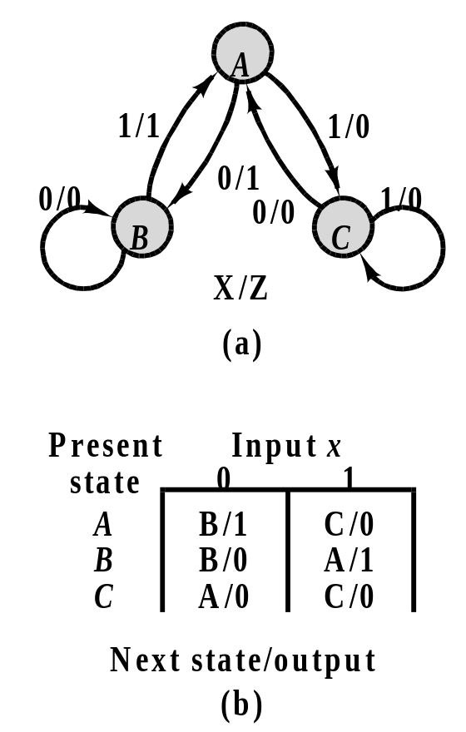
Mealy Machine Model
Figure 8.2

Slide 18
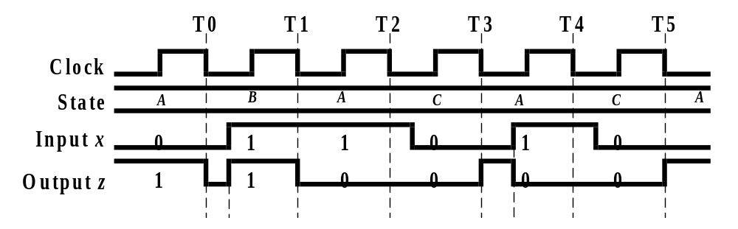
Mealy Machine Timing Diagram -- Example 8.1
Figure 8.3

Slide 19
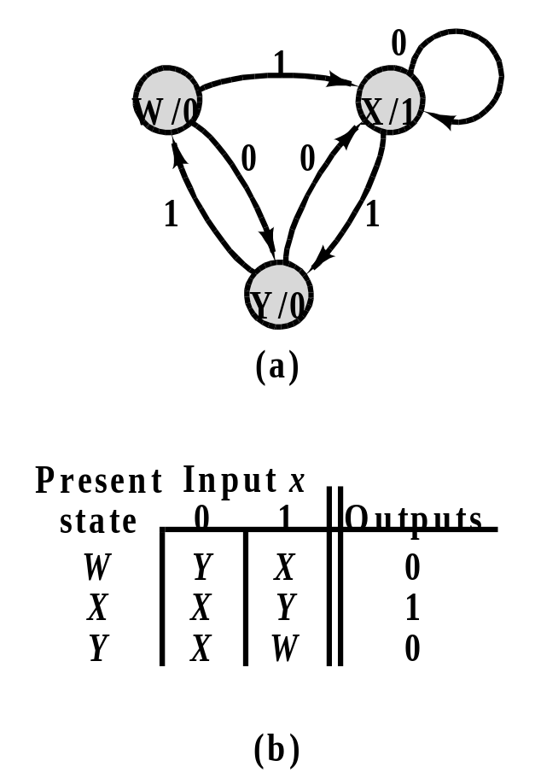
Moore Machine Model
Figure 8.4

Slide 20
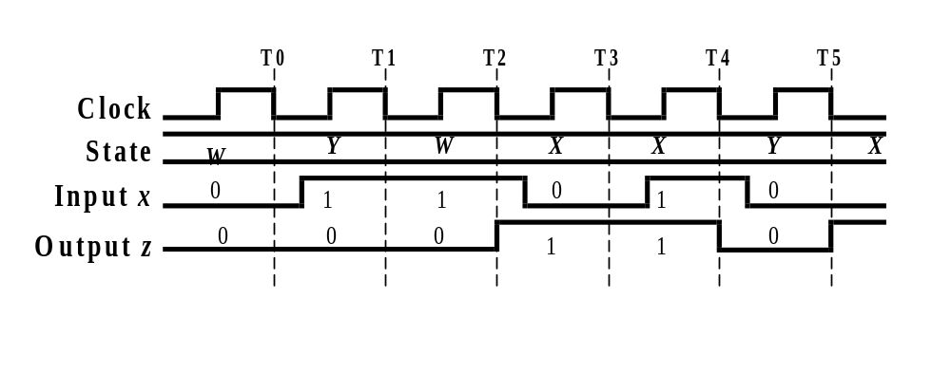
Moore Machine Timing Diagram -- Example 8.2
Figure 8.5

Slide 21
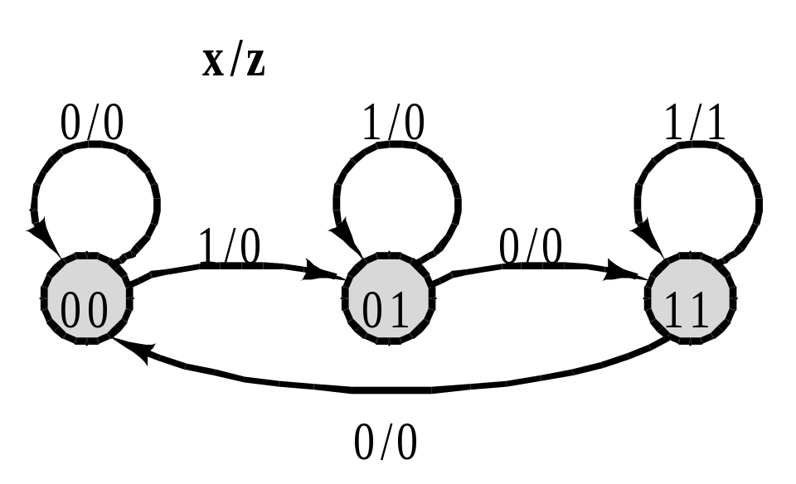
Analysis of Sequential Circuit State Diagrams -- Example 8.3
Figure 8.6

Slide 22
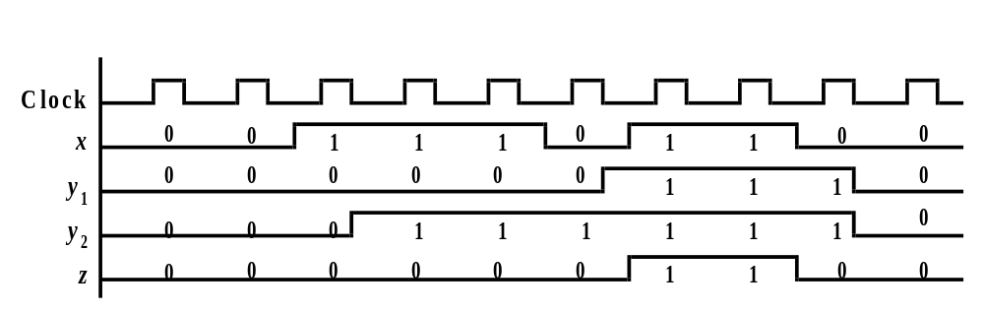
Timing Diagram for Example 8.3
Figure 8.7

Slide 23
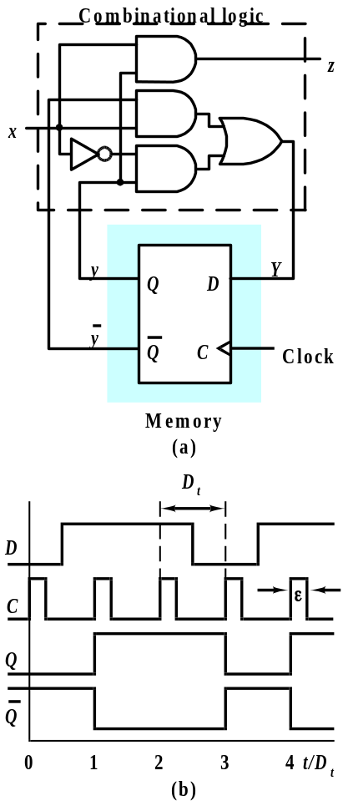
Analysis of Sequential Circuit Logic Diagrams
Figure 8.8

Slide 24
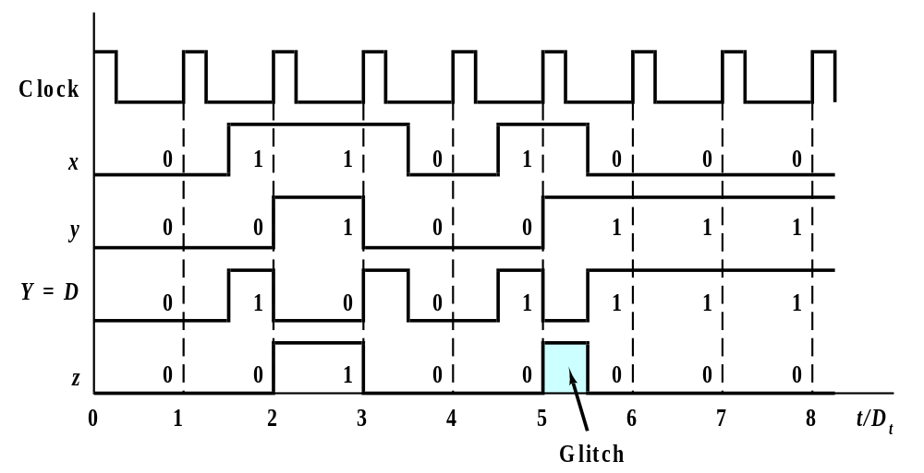
Timing Diagram for Figure 8.8 (a)
Figure 8.9

Slide 25
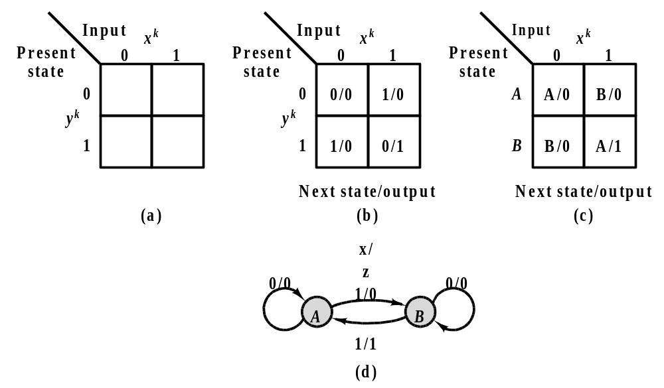
State Table and State Diagram for Figure 8.8 (a)
Figure 8.10

Slide 26
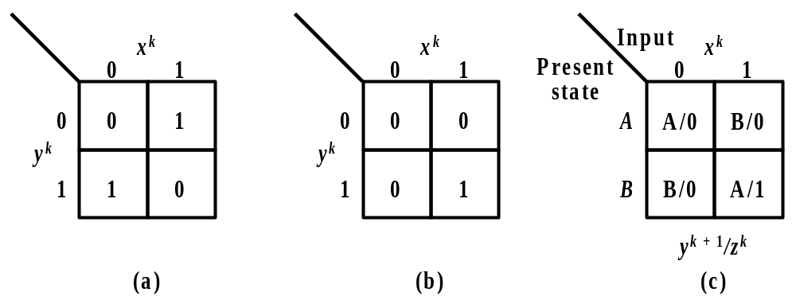
K-Maps for Circuit of Figure 8.8 (a)
Figure 8.11

Slide 27
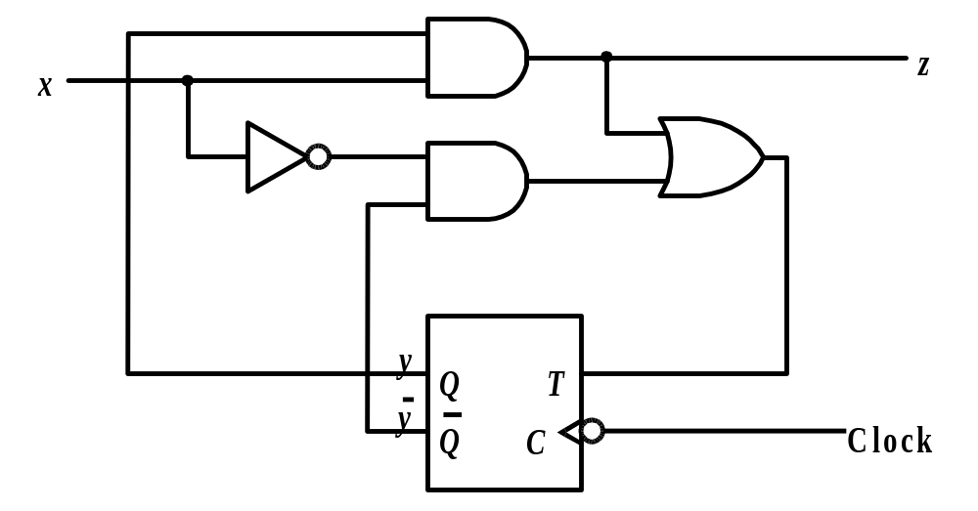
Synchronous Sequential Circuit with T Flip-Flop -- Example 8.4
Figure 8.12

Slide 28
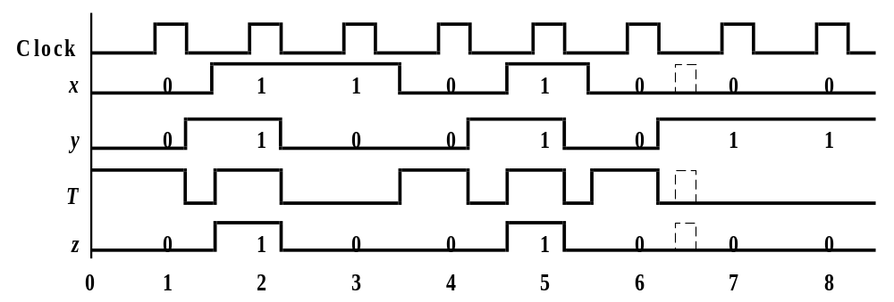
Timing Diagram for Example 8.4
Figure 8.13

Slide 29
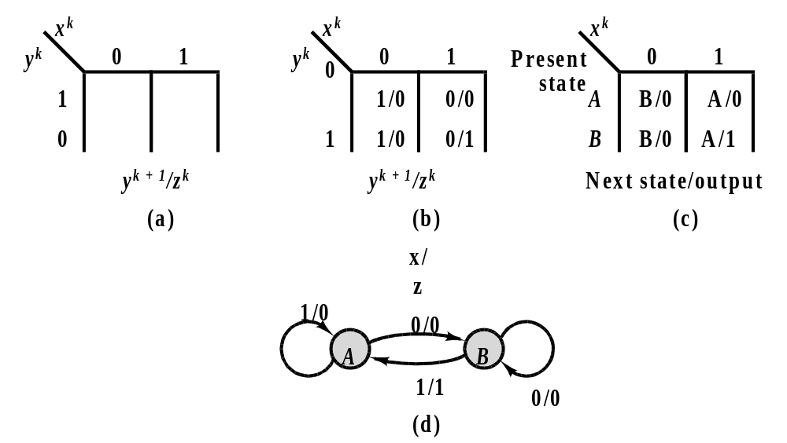
State Table and State Diagram for Example 8.4
Figure 8.14

Slide 30
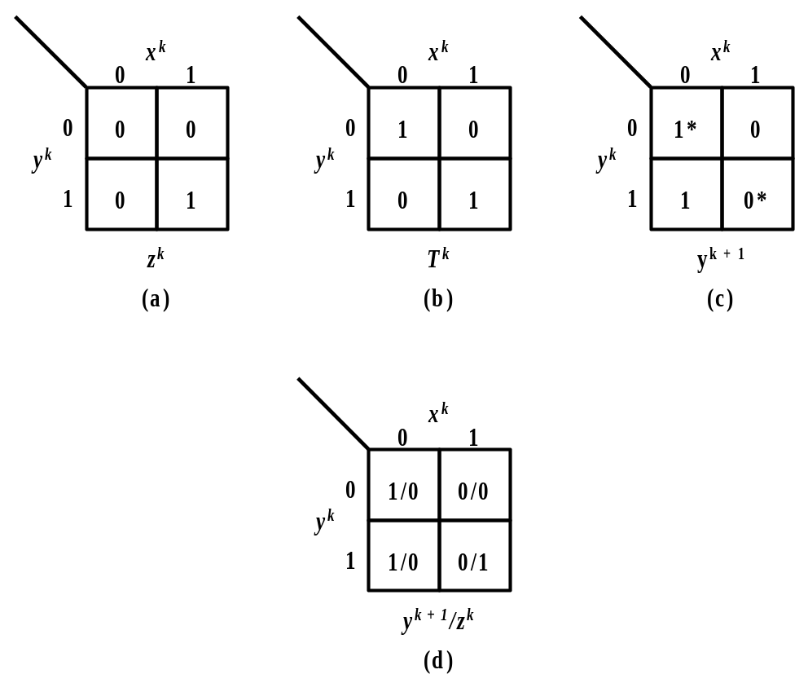
K-Maps for Example 8.4
Figure 8.15

Slide 31
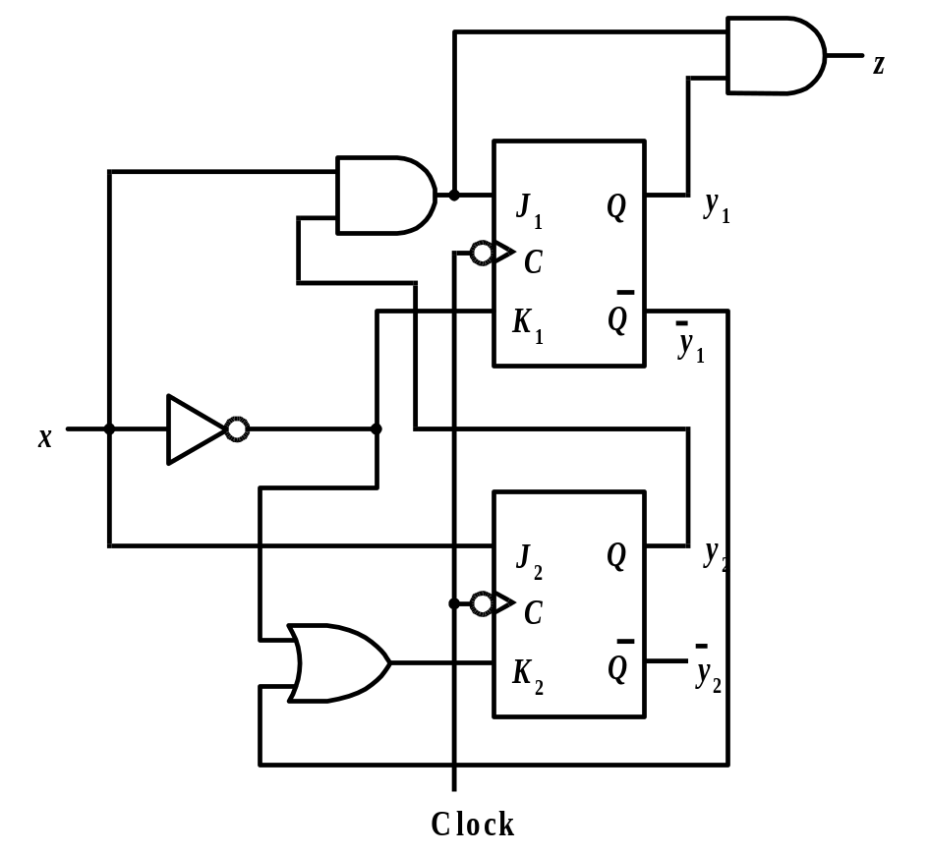
Synchronous Sequential Circuit with JK Flip-flops -- Example 8.5
Figure 8.16

Slide 32
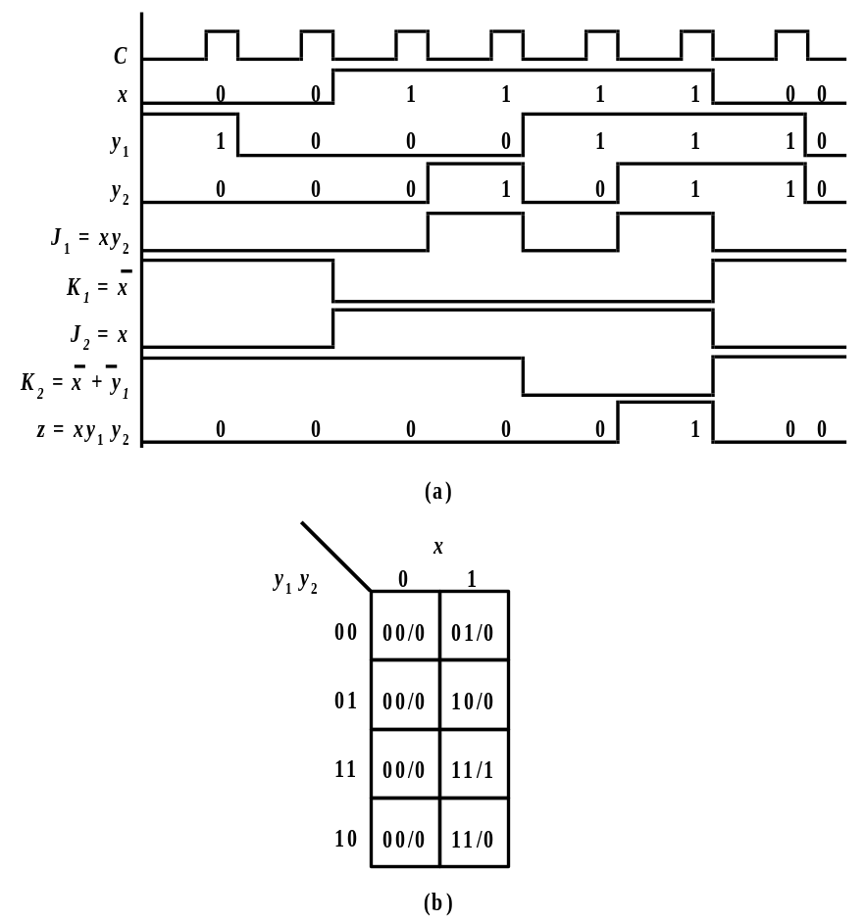
Timing Diagram and State Table for Example 8.5
Figure 8.17

Slide 33
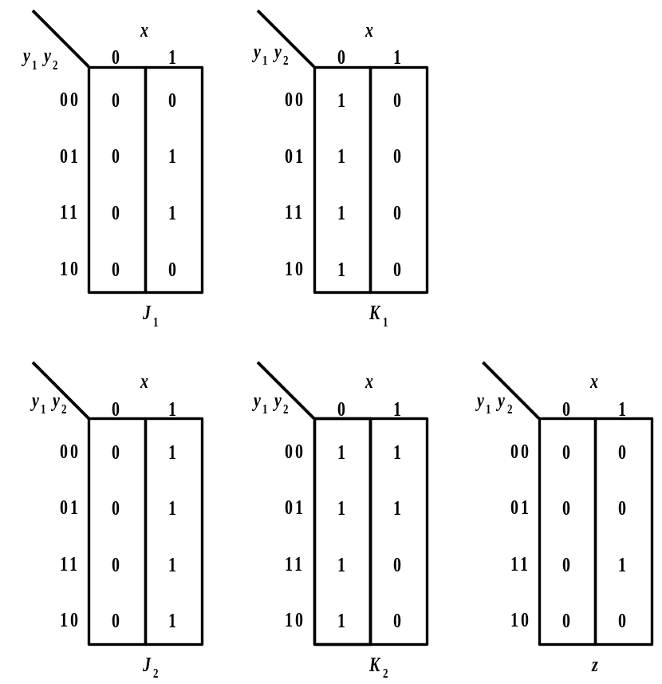
K-Maps for Example 8.5
Figure 8.18

Slide 34
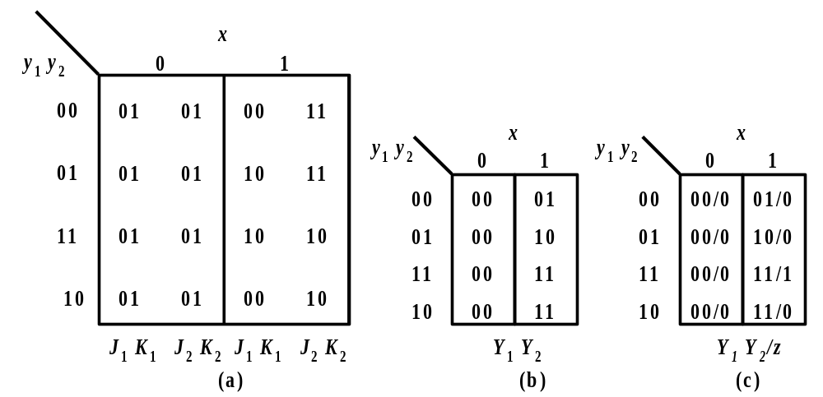
Generating the State Table From K-maps --
Example 8.5
Figure 8.19

Slide 35
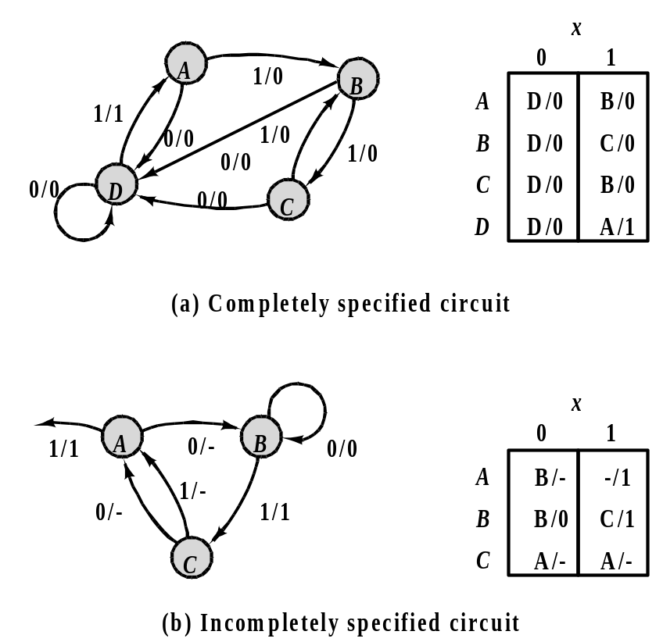
Synchronous Sequential Circuit Synthesis
Figure 8.20

Slide 36
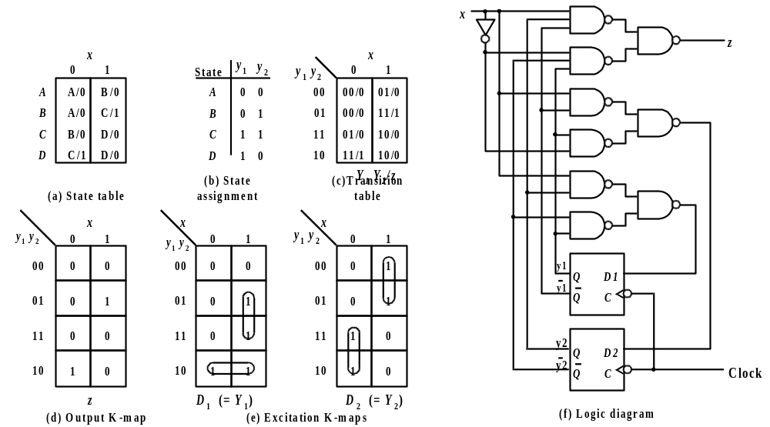
Introductory Synthesis Example -- Example 8.6
Figure 8.21

Slide 37
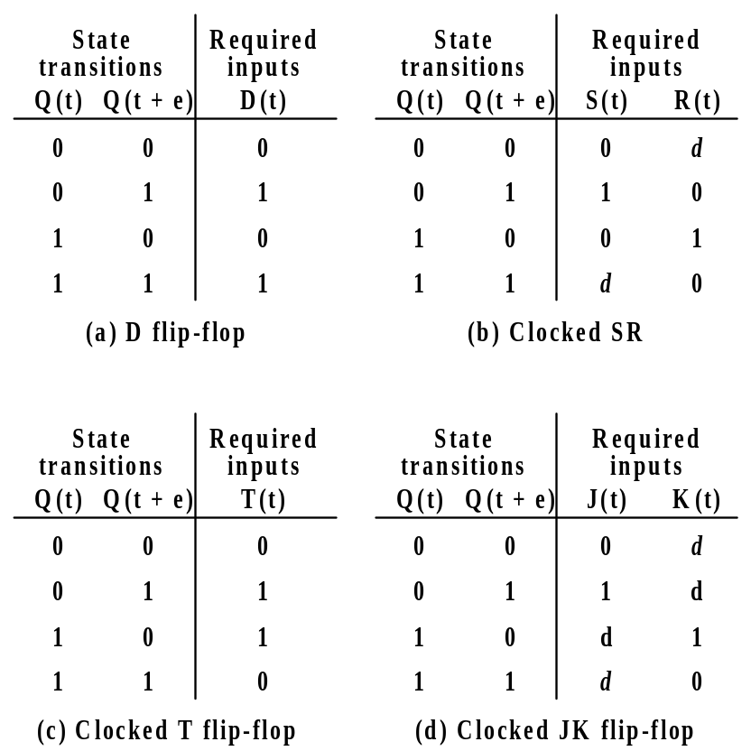
Flip-flop Input Tables -- Example 8.6
Figure 8.22

Slide 38
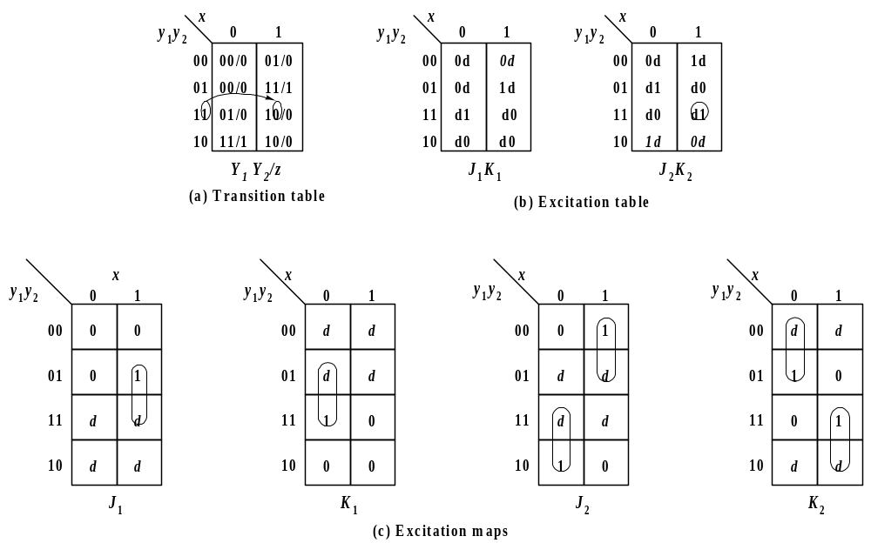
Generating the JK Flip-flop Excitation Maps --
Example 8.7
Figure 8.23

Slide 39
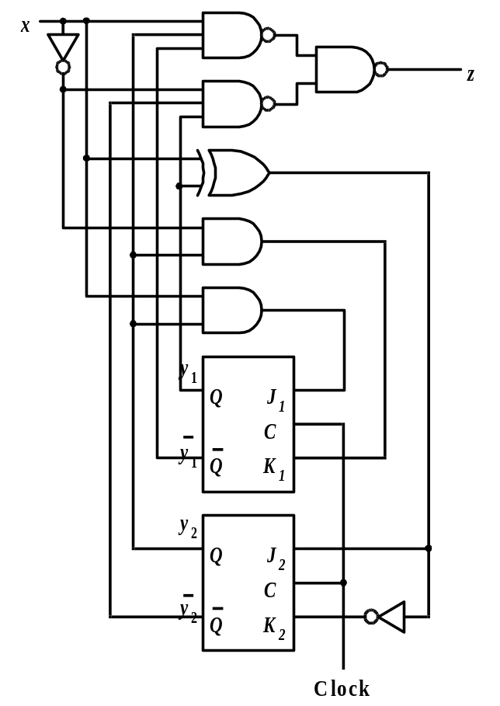
Clocked JK Flip-Flop Implementation --
Example 8.7
Figure 8.24

Slide 40
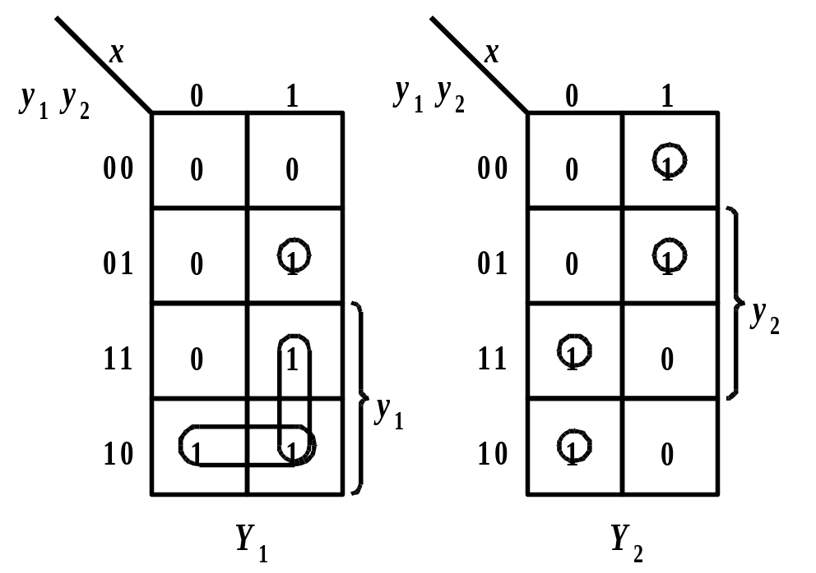
Application Equation Method for Deriving Excitation Equations -- Example 8.8
Figure 8.25

Slide 41
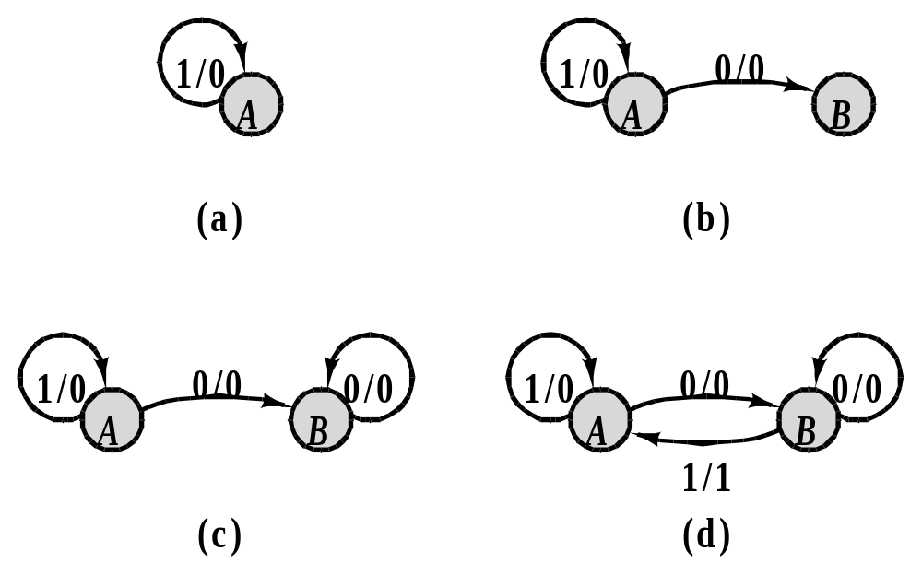
Sequence Recognizer for 01 Sequence --
Example 8.9
Figure 8.26

Slide 42
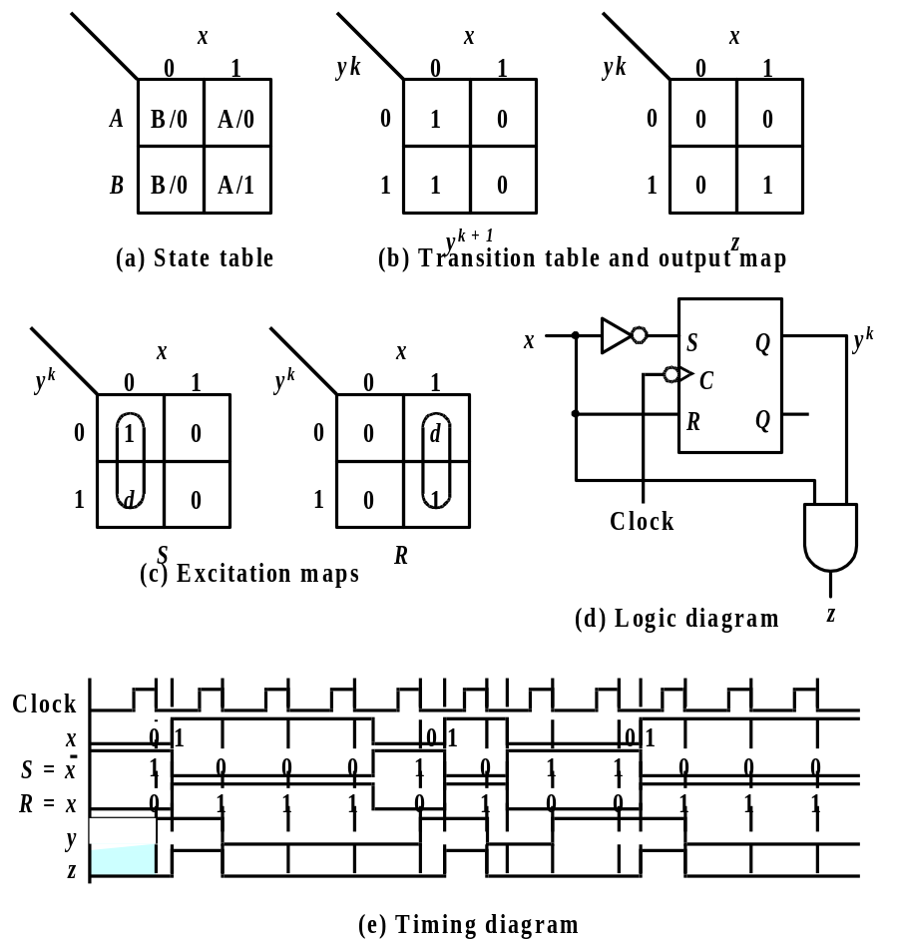
Synthesis of the 01 Recognizer with SR Flip-flops
Figure 8.27

Slide 43
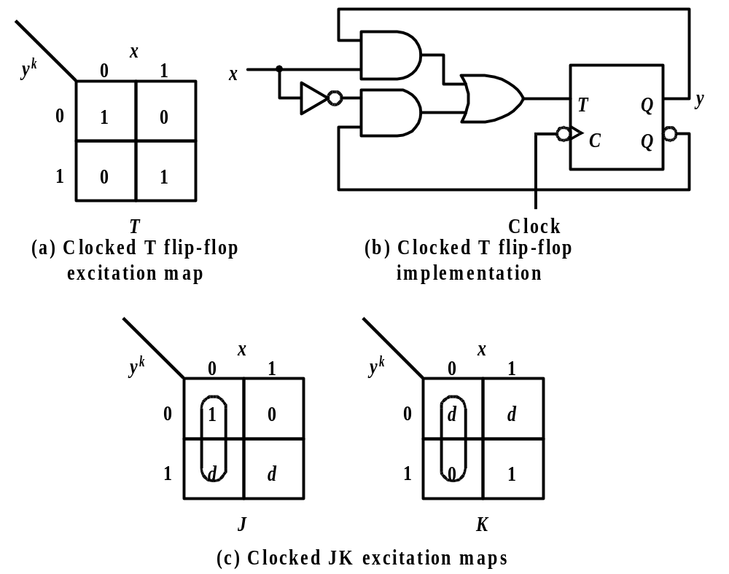
Realization of 01 Recognizer with T Flip-flops
Figure 8.28

Slide 44
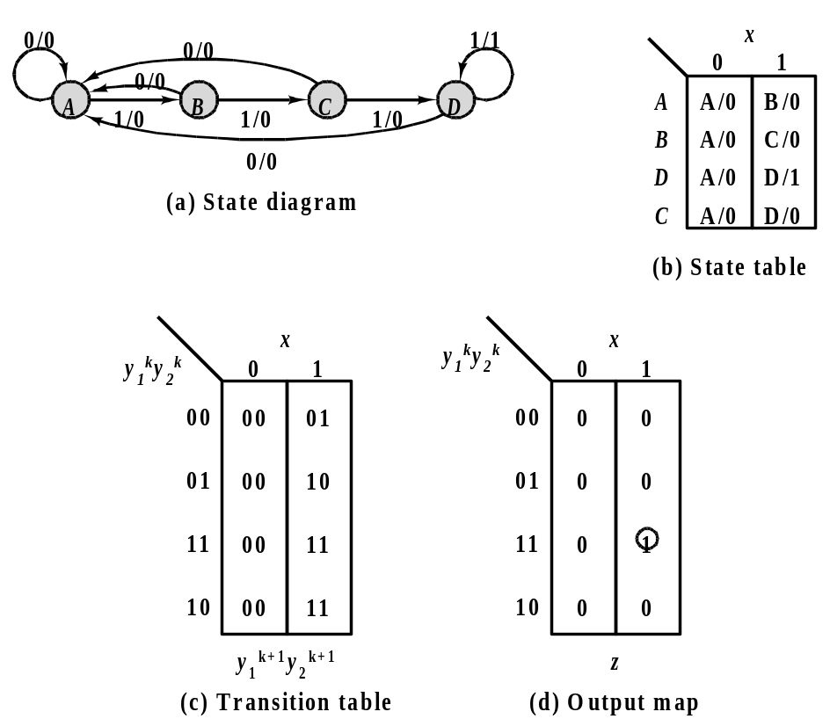
Design of a Recognizer for the Sequence 1111 --
Example 8.11
Figure 8.29

Slide 45
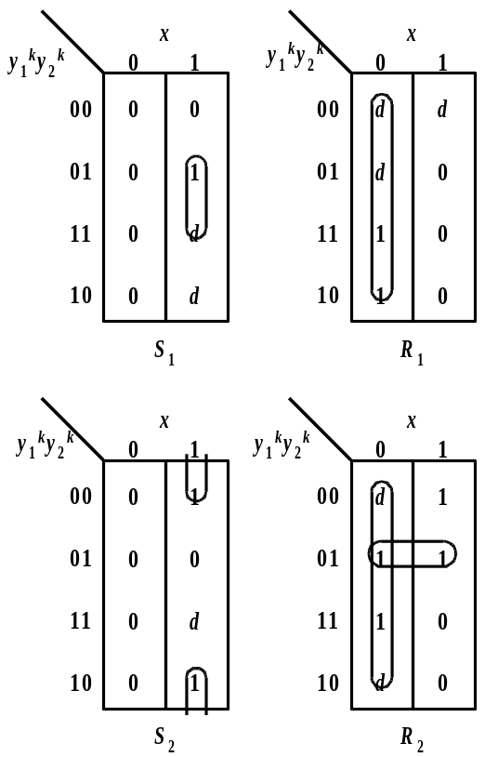
SR Realization of the 1111 Recognizer
Figure 8.30

Slide 46
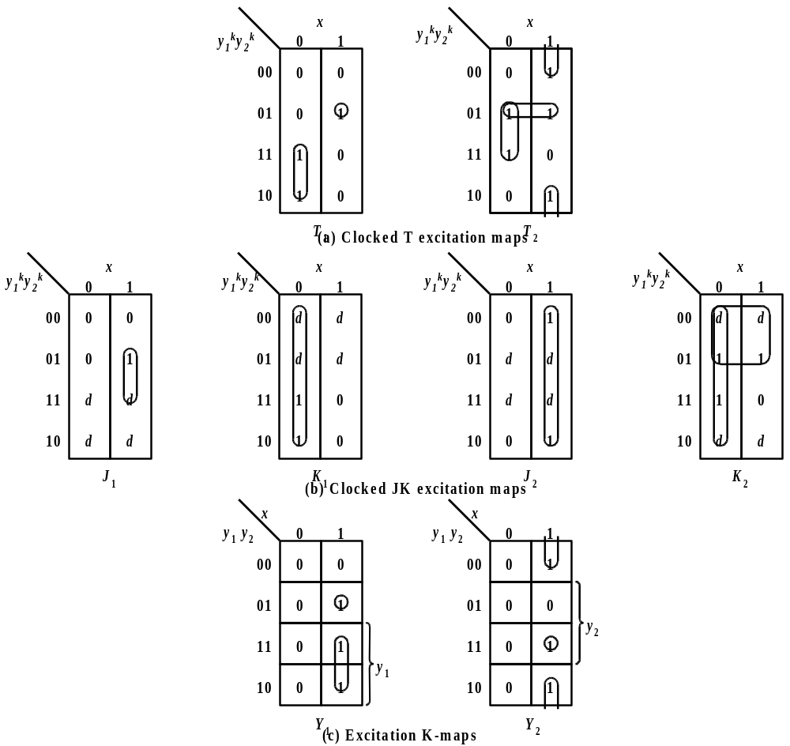
Clocked T and JK Realizations of the 1111 Recognizer
Figure 8.31

Slide 47
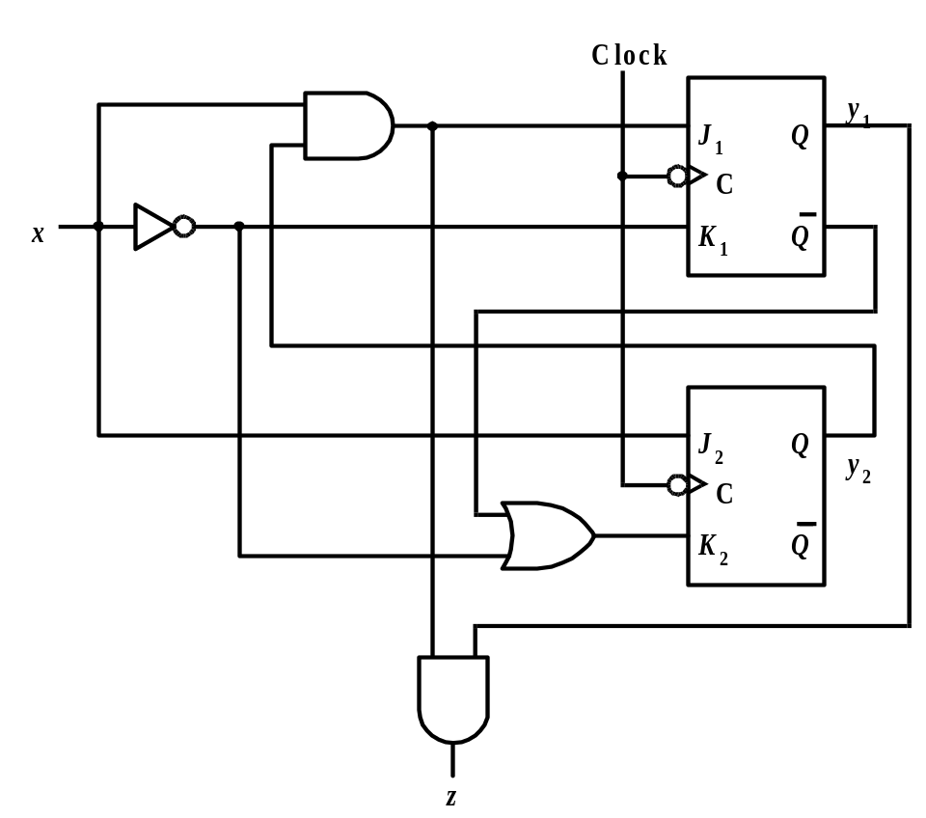
Clocked JK Flip-Flop Realization of a 1111 Recognizer
Figure 8.32

Slide 48
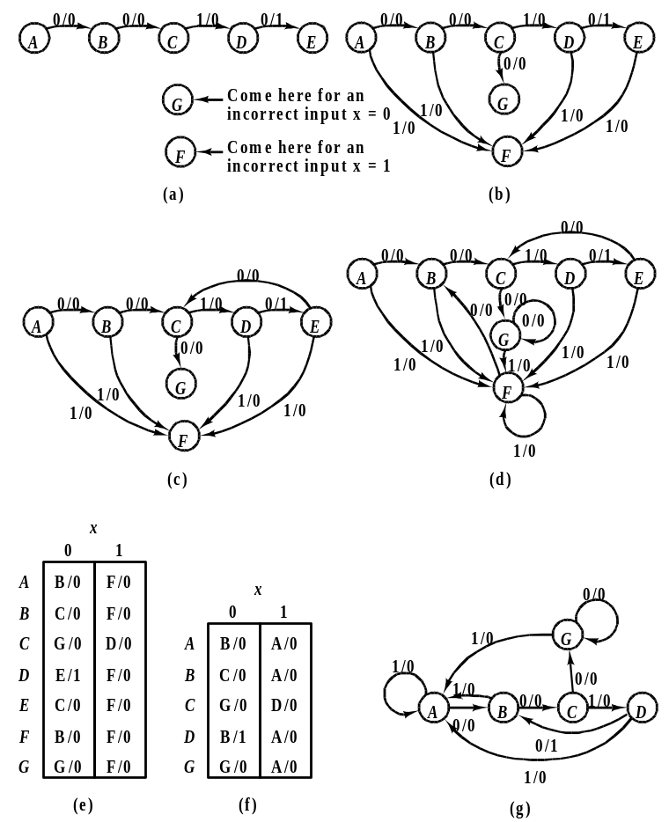
Design of a 0010 Recognizer
Figure 8.33

Slide 49
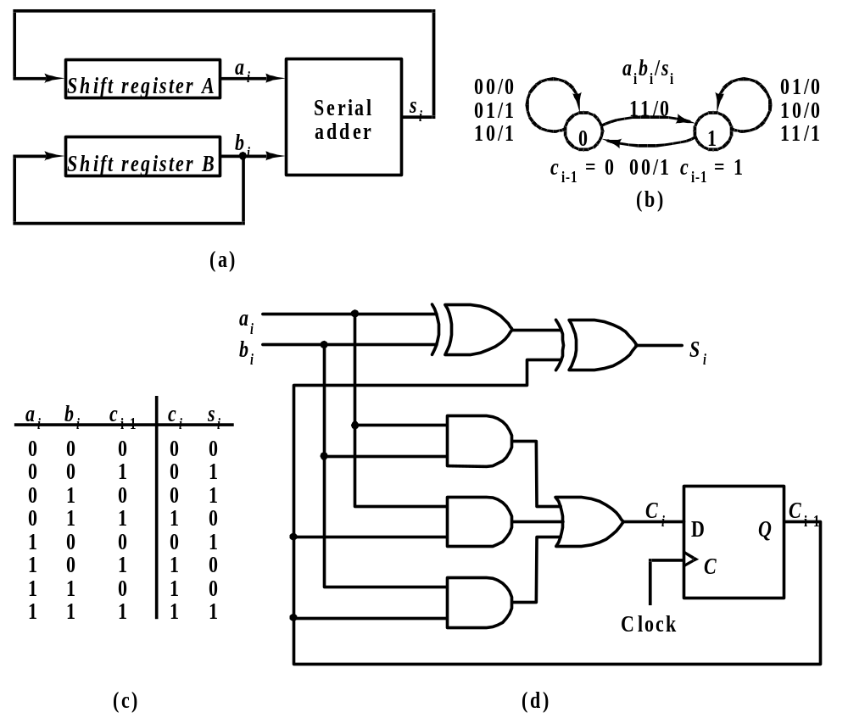
Design of a Serial Binary Adder
Figure 8.34

Slide 50
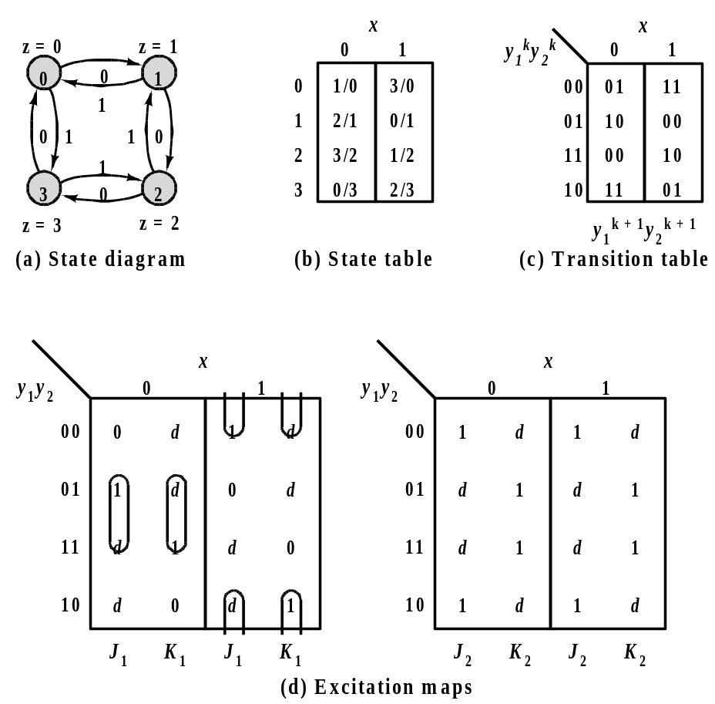
Design of a Four-State Up/Down Counter
Figure 8.35

Slide 51
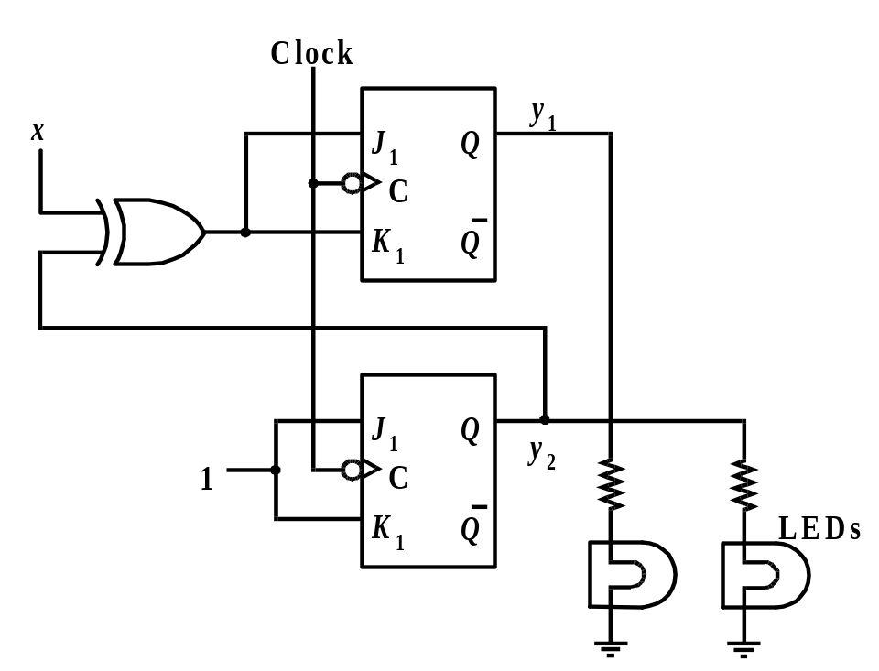
An Implementation of the Up/Down Counter
Figure 8.36

Slide 52
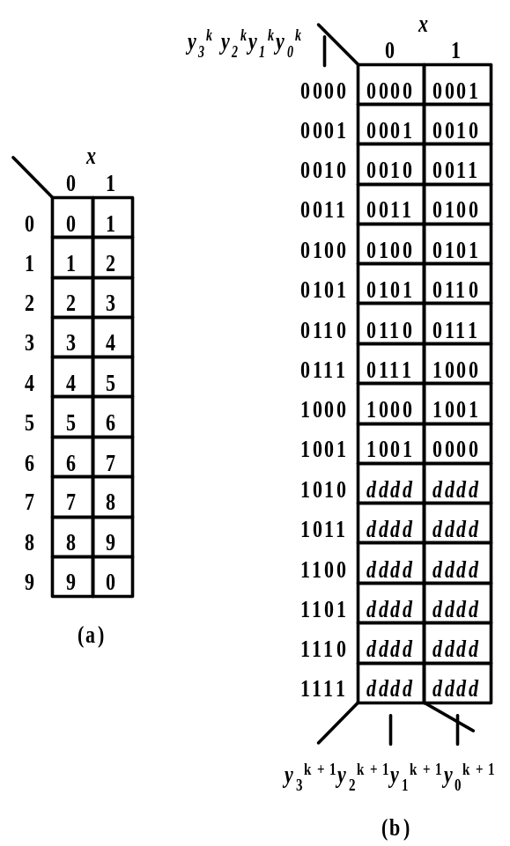
Design a BCD Counter
Figure 8.37 (a) and (b)

Slide 53
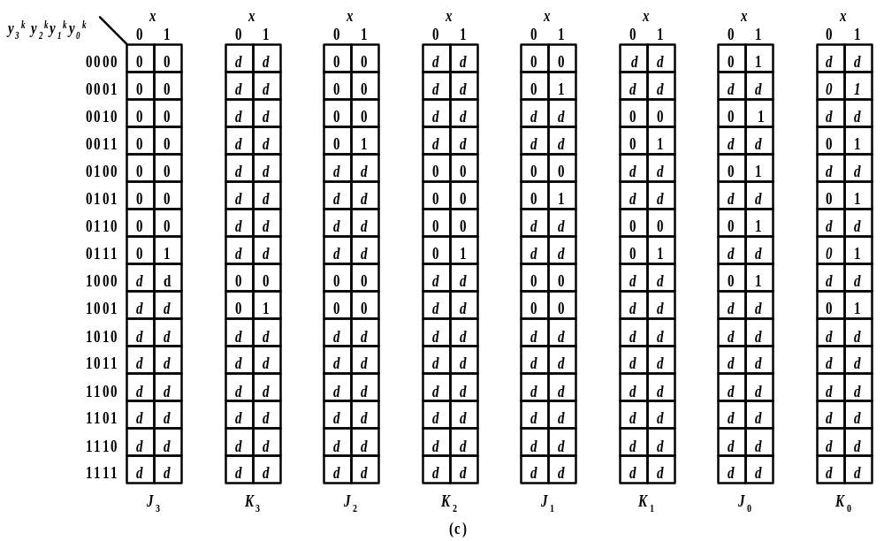
Design of the BCD Counter (con’t)
Figure 8.37 (c)

Slide 54
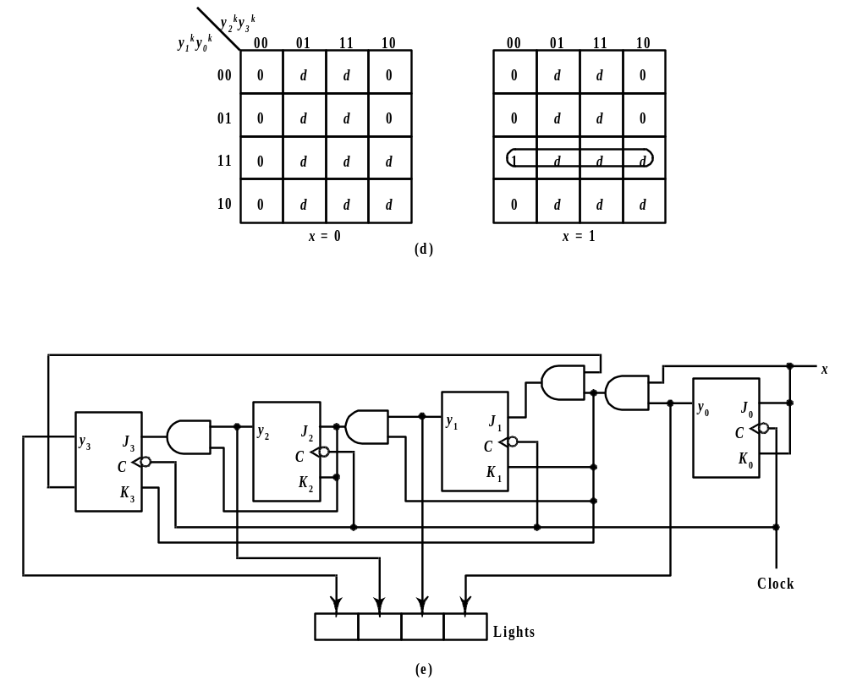
Realization of the BCD Counter Design
Figure 8.37 (d) and (e)

Slide 55
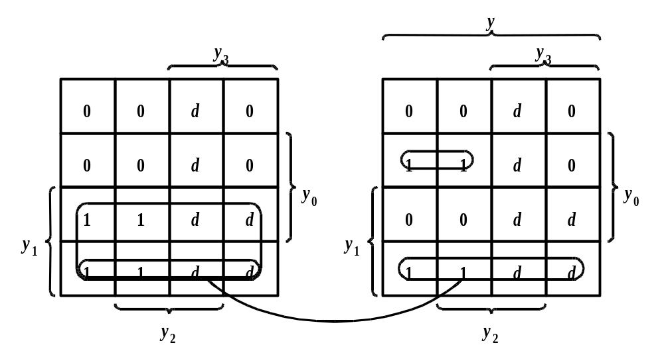
K-map For Y₁ in Example 8.16
Figure 8.38

Slide 56
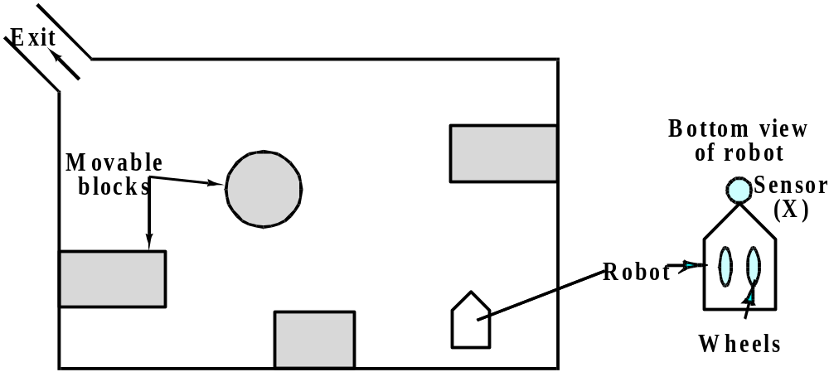
Robot Controller Floor Plan -- Example 8.17
Figure 8.39

Slide 57
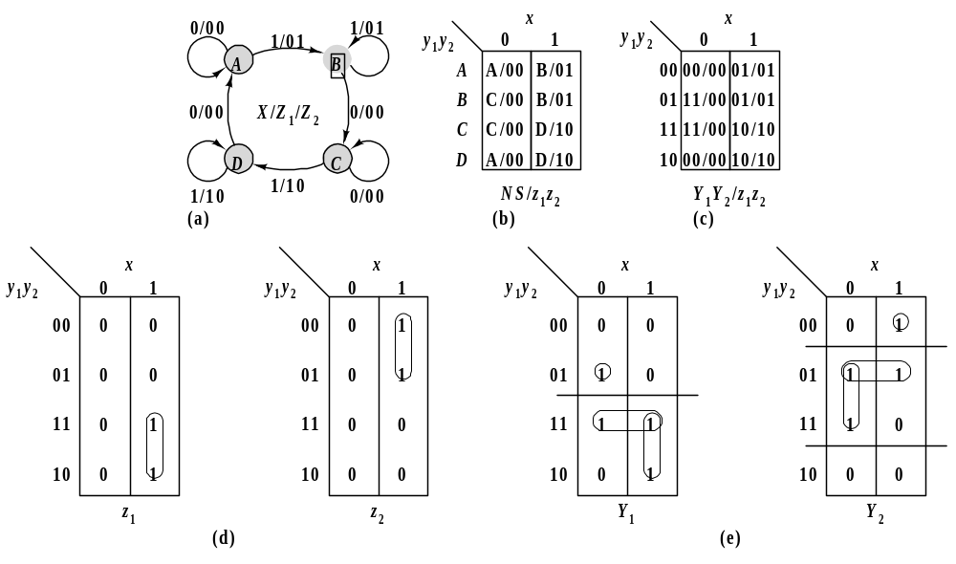
Robot Controller Design
Figure 8.40 (a) -- (e)

Slide 58

Robot Controller Realization
Figure 8.40 (f)

Slide 59

Candy Machine Controller Design -- Example 8.18
Figure 8.41

Slide 60

Algorithmic State Machines (ASMs)
Figure 8.42

Slide 61

ASM Representation of a Mealy Machine
Figure 8.43

Slide 62

ASM Representation of a Moore Machine
Figure 8.44

Slide 63

Eight-Bit Two’s Complementer ASM --
Example 8.19
Figure 8.45

Slide 64

Binary Multiplier Controller -- Example 8.20
Figure 8.46

Slide 65

One-Hot State Assignments
Table 8.1

Slide 66

ASM Design Using One-Hot State Assignments
Figure 8.47 (a) -- (b)

Slide 67

ASM Design Using One-Hot Assignments (con’t)
Figure 8.47 (c)

Slide 68

One-hot Design of A Multiplier Controller -- Example 8.21
Figure 8.48

Slide 69

Incompletely Specified Circuits -- Detonator (Example 8.22)
Figure 8.49

Slide 70

Detonator Example K-maps
Figure 8.50

Slide 71

Detonator Realization
Figure 8.51

Slide 72

Sate Assignments and Circuit Realization
Figure 8.52

